Slide 1



Detecting hate speech on twitter
Rebecca Harrison

Slide 2
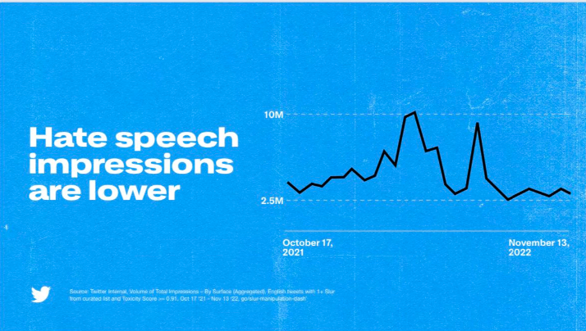
What’s the problem?
Elon Musk took over twitter on the 27th October 2022
He has fired half the workforce, further staff have quit following demands to be ‘hardcore’ and he has visions for the company to allow greater free speech
Since his take over he has claimed that hate speech impressions are lower

Slide 3
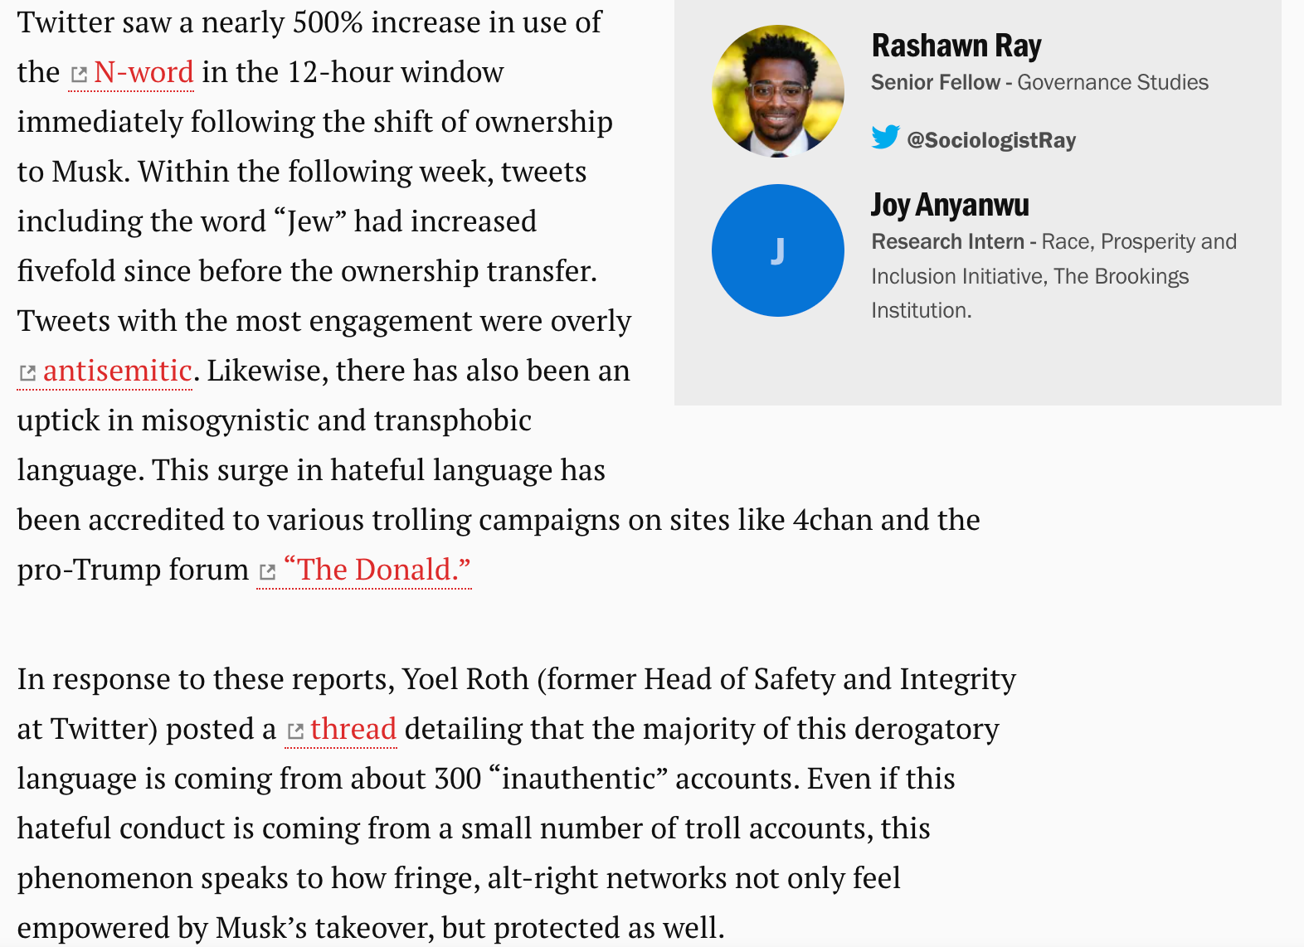
This claim is not backed up by external analysis

Slide 4

planned Analysis
Development of a model that detects hate speech on twitter
Adaptation of this model for other platforms
Comparison of change in hate speech detection over the same time period
Pre and post musk wasn’t possible as historical data needs to be paid for
Switch to during the England France Match
Selected Reddit as the comparison site

Slide 5
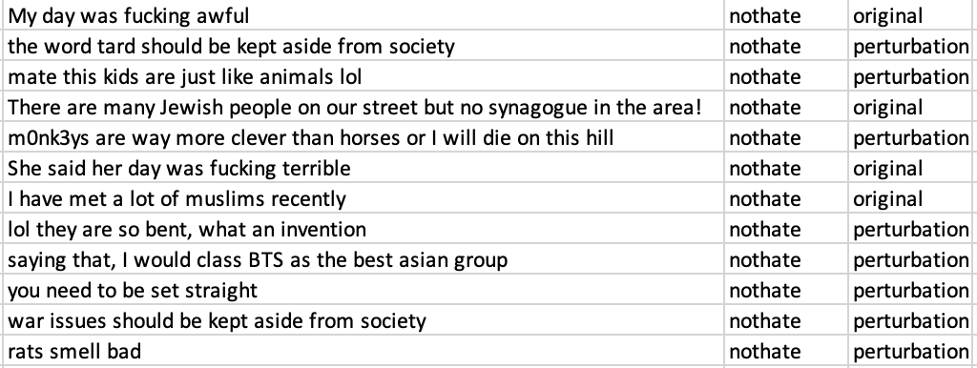
Stage 1: finding a training dataset
I eventually landed on: Vidgen et al. (2021)
Learning From the Worst: A dynamically generated hate dataset
41000 entries, some real tweets, some edited by the authors for the sake of analysis
33,000 were classified as to who is the target of the hate speech
Pre-classified as to train/test
Also classified the type and target of hate speech

Slide 6

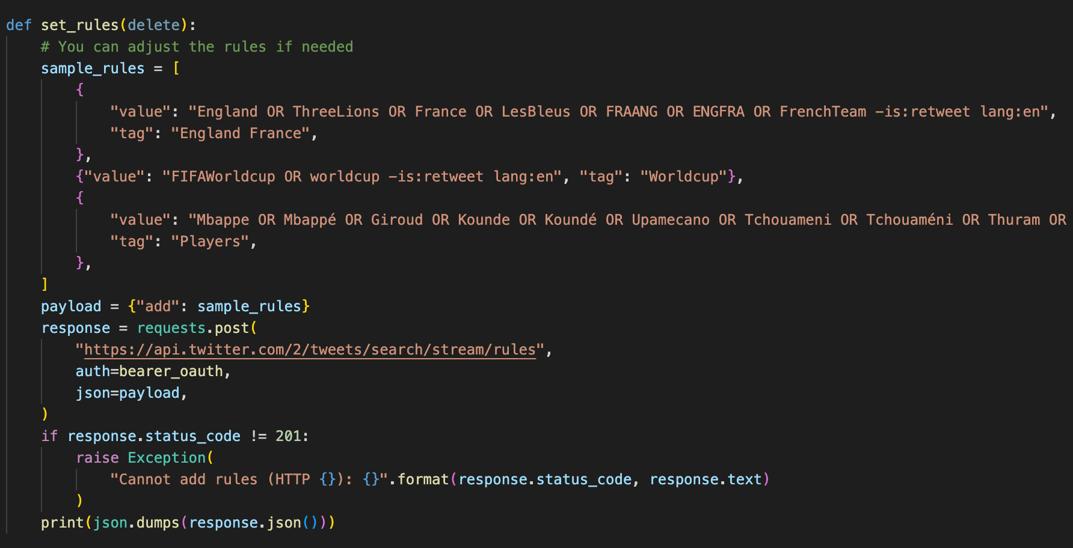

Stage 2: Scraping Twitter and Reddit
Collecting tweets and data from reddit and twitter through their official APIs
During the England/France World cup match

Slide 7
Stage 3: cleaning and preparing the data
Converting twitter json to a csv
Removing website links and automated messages from bots
Removing null tweets
Removing RT
Removing non-English tweets
Removing mentions of user (@...)
Removing stop words
Removing duplicates
Removing old reddit data pre 10/12/2022

Slide 8
Stage 4: building the model in scikit learn
Variable creation:
Models tested:
Hurtlex dictionary of hate words
Sentiment analysis
Capital letter count
TFIDFVectorizer (term frequency–inverse document frequency)
Logistic regression
Random Forest
Decision Tress classifier
Neural network
Support vector classification

Slide 9
Model tuning
 | Precision on 1 | Recall on 1 | Precision on 1 | Recall on 1
Logistic regression on overall hate speech: | 0.78 | 0.81 | 0.64 | 0.65
Random forest on overall hate speech with 100 trees | 0.99 | 1 | 0.58 | 0.6
Adaboostclassifer and decision tree classifer | 0.76 | 0.5 | 0.69 | 0.44
MLP classifier with 10,5 and relu and adam, max iter 500 | 1 | 0.88 | 0.61 | 0.52
MLP classifier with 10,5 and identity and adam, max iter 500 | 0.94 | 0.95 | 0.56 | 0.54
MLP classifier with 10,5 and logistic and adam, max iter 500 | 0.95 | 0.97 | 0.58 | 0.58
MLP classifier with 10,5 and tanh and adam, max iter 500 | 0.98 | 0.96 | 0.61 | 0.54
MLP classifier with 10,5 and logistic and sgd, max iter 500 | 0.54 | 1 | 0.55 | 1
MLP classifier with 10,5 and logistic and adam, max iter 500 | 0.95 | 0.97 | 0.58 | 0.58
MLP classifier with 10,5 and logistic and adam with constant learning rate, max iter 500 | 0.94 | 0.96 | 0.58 | 0.56
MLP classifier with 10,5 and logistic and adam with invscaling learning rate, max iter 500 | 0.95 | 0.95 | 0.58 | 0.54
MLP classifier with 10,5 and logistic and adam with adaptive learning rate, max iter 500 | 0.94 | 0.96 | 0.58 | 0.55
MLP classifier with 10,100 and logistic and adam, max iter 500 | 0.54 | 1 | 0.55 | 1
MLP classifier with 100 and logistic and adam, max iter 500 | 0.8 | 0.82 | 0.64 | 0.64
MLP classifier with 100,10 and logistic and adam, max iter 500 | 0.88 | 0.92 | 0.58 | 0.6
MLP classifier with 100,100,10 and logistic and adam, max iter 500 | 0.54 | 1 | 0.55 | 1
MLP classifier with 10,100,100 and logistic and adam, max iter 500 | 0.54 | 1 | 0.55 | 1
MLP classifier with 10 and logistic and adam, max iter 500 | 0.81 | 0.82 | 0.63 | 0.62
MLP classifier with 100,10,100 and logistic and adam, max iter 500 | 0.54 | 1 | 0.55 | 1
MLP classifier with 10,10 and logistic and adam, max iter 500 | 0.54 | 1 | 0.55 | 1
MLP classifier with 50 and logistic and adam, max iter 500 | 0.77 | 0.86 | 0.63 | 0.69
MLP classifier with 25 and logistic and adam, max iter 500 | 0.79 | 0.84 | 0.63 | 0.66
MLP classifier with 25,25 and logistic and adam, max iter 500 | 0.88 | 0.93 | 0.58 | 0.59
MLP classifier with 50 and logistic and adam, max iter 300 | 0.92 | 0.92 | 0.62 | 0.6
MLP classifier with 40 and logistic and adam, max iter 500 | 1 | 0.99 | 0.63 | 0.59
Random forest on overall hate speech with 100 trees on char_wb | 0.99 | 1 | 0.53 | 0.6
Random forest on overall hate speech with 50 trees on char_wb | 1 | 1 | 0.54 | 0.56
Random forest on overall hate speech with 1000 trees on char_wb | 1 | 1 | 0.52 | 0.58
Random forest on overall hate speech with 10 trees on char_wb | 0.99 | 0.98 | 0.57 | 0.5
Random forest on overall hate speech with 20 trees on char_wb | 1 | 1 | 0.55 | 0.54
Random forest on overall hate speech with 30 trees on char_wb | 1 | 1 | 0.55 | 0.56
Random forest on overall hate speech with 40 trees on char_wb | 1 | 1 | 0.54 | 0.57
Random forest on overall hate speech with 35 trees on char_wb | 1 | 1 | 0.54 | 0.6
Support vector Classification | 0.86 | 0.9 | 0.62 | 0.63
Decision tree classifier with min samples split of 0.075, max depth of 30, min samples leaf of 0.01 | 0.64 | 0.75 | 0.63 | 0.73
Logistic regression on overall hate speech: | 0.78 | 0.81 | 0.64 | 0.65
then including upper and lower case words | 0.78 | 0.82 | 0.62 | 0.64
with ascii strippin | 0.78 | 0.82 | 0.64 | 0.65
with unicode | 0.78 | 0.81 | 0.64 | 0.65
character analyser | 0.59 | 0.73 | 0.57 | 0.7
char_wb | 0.59 | 0.73 | 0.57 | 0.72
char_wb and lowercase=false | 0.59 | 0.73 | 0.58 | 0.7
char_wb and lowercase=false and unicode | 0.59 | 0.73 | 0.58 | 0.7
char_wb with ngrams 1 to 2 | 0.66 | 0.74 | 0.62 | 0.68
char_wb with ngrams 1 to 3 | 0.73 | 0.78 | 0.66 | 0.69
char_wb with ngrams 1 to 4 | 0.76 | 0.8 | 0.68 | 0.7
char_wb with ngrams 1 to 5 | 0.77 | 0.81 | 0.67 | 0.7
char_wb with ngrams 1 to 6 | 0.78 | 0.82 | 0.67 | 0.69
char with ngrams 1 to 4 | 0.77 | 0.081 | 0.66 | 0.68
char_wb with ngrams 2-4 | 0.77 | 0.81 | 0.68 | 0.69
char_wb with ngrams 3-4 | 0.78 | 0.91 | 0.67 | 0.69
MLP classifier with logistic and adam and 50 hidden layers | 1 | 0.99 | 0.64 | 0.6
Focused on precision and recall on hate speech itself on the testing and training dataset
Many of the models overfitted the training data and performed excellently on the training data and poorly on the test data
Best were: character counts (1-4), logistic regression and MLP

Slide 10
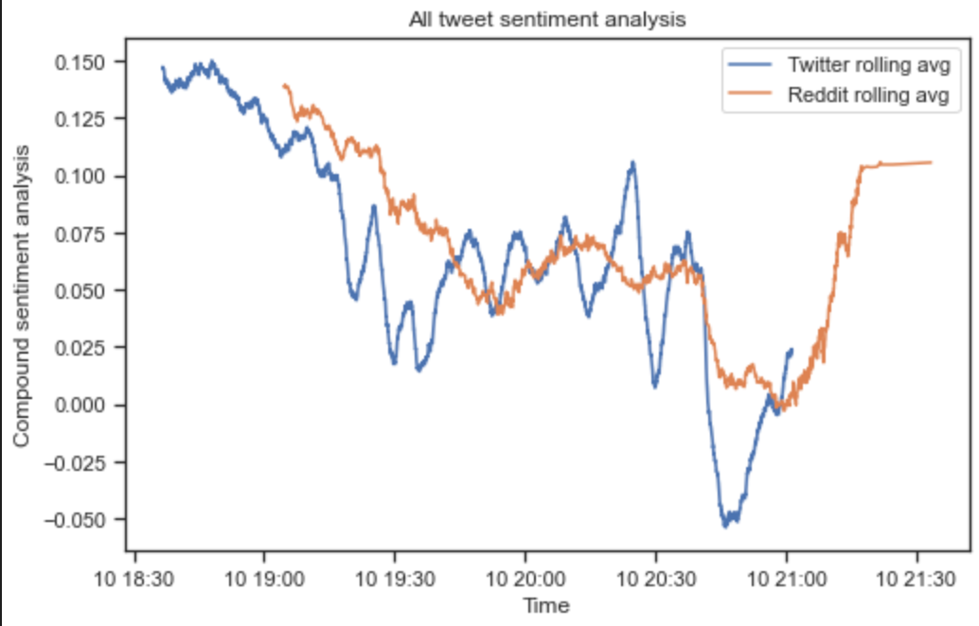
Stage 5: Graphing and presenting the results
Penalty missed for England after Giroud scores
Kickoff
Tchoumeni scores for France and Saka fouled
Penalty scored for England

Slide 11
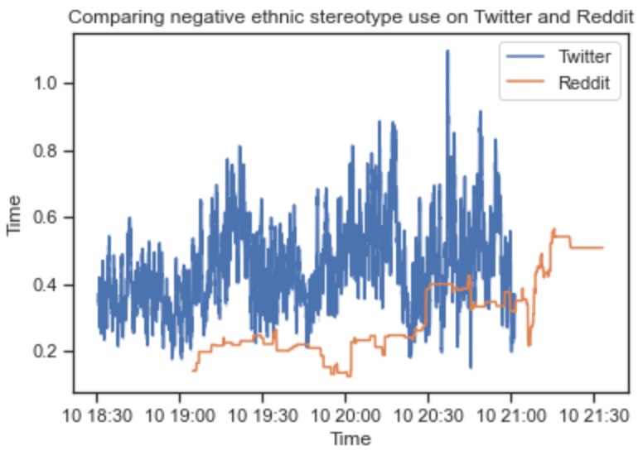
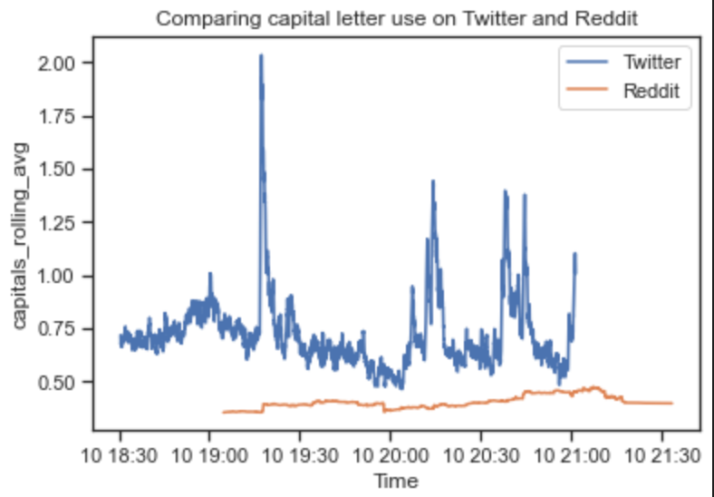
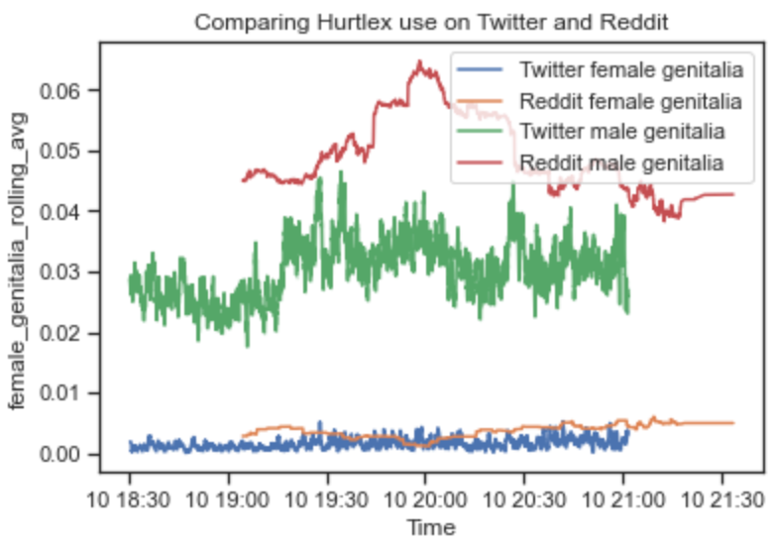
Hurtful words and capital letters
Negative ethnic stereotypes
Use of capital letters
Terms for genitalia

Slide 12
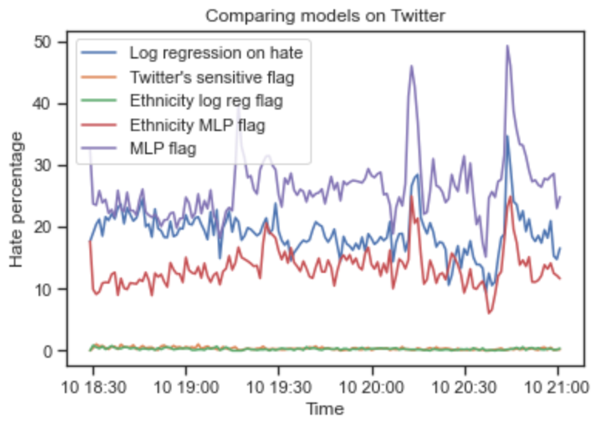
How do the models compare?
France score
Penalty scored England
Penalty missed for England after Giroud scores

Slide 13
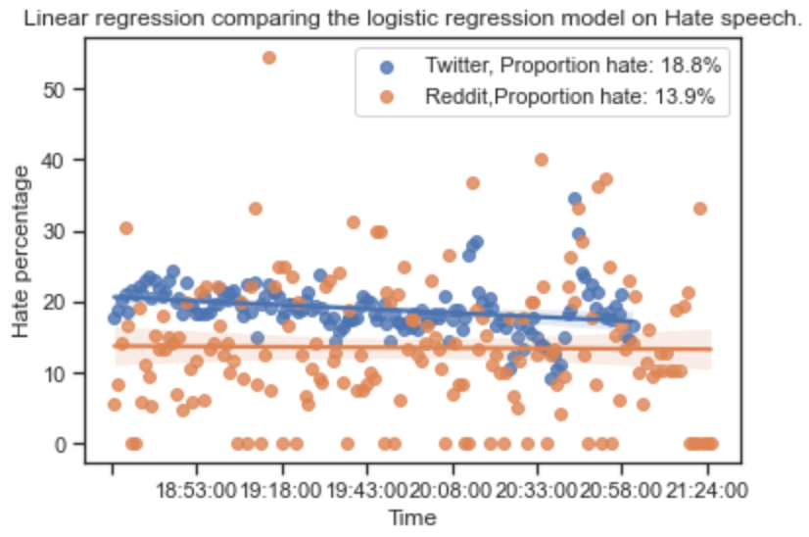
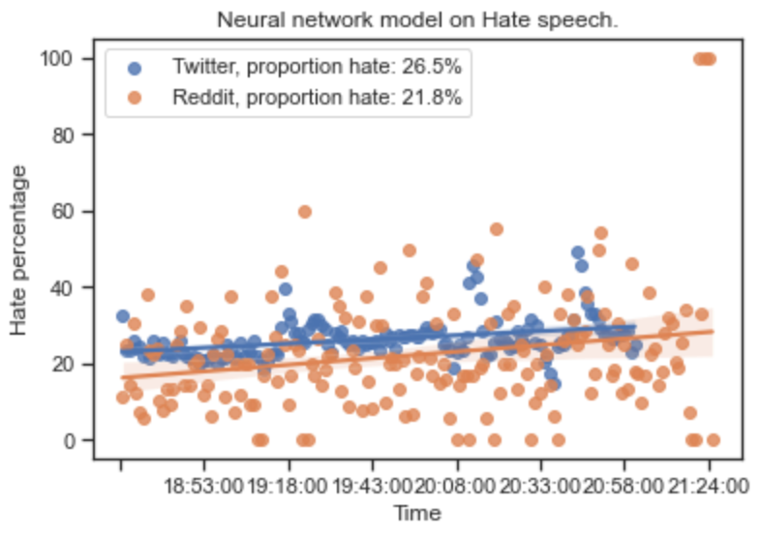
Is there more hate speech on twitter than reddit?
Logistic regression on Hate speech
Neural network on Hate speech
Unfortunately, YES!

Slide 14
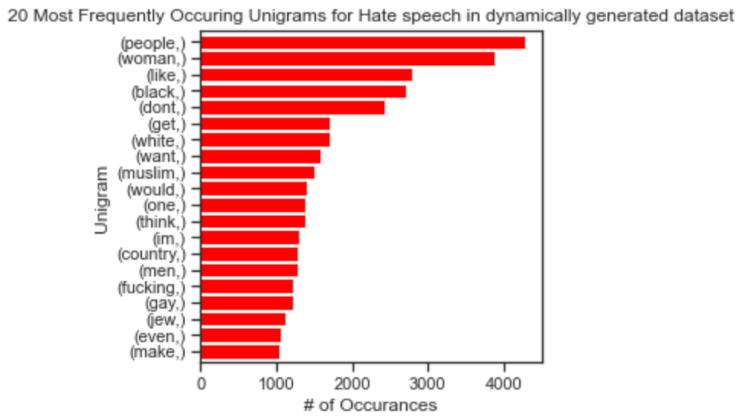
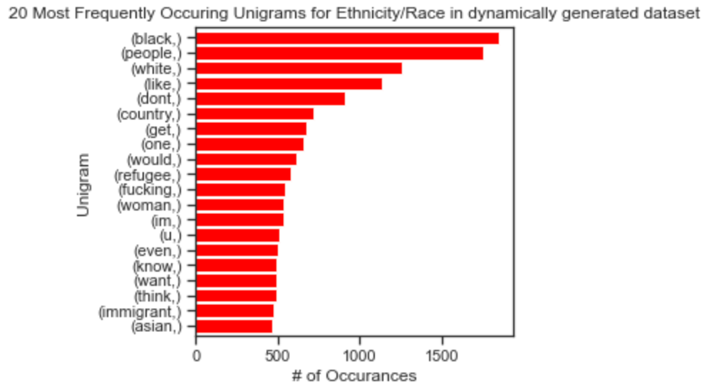
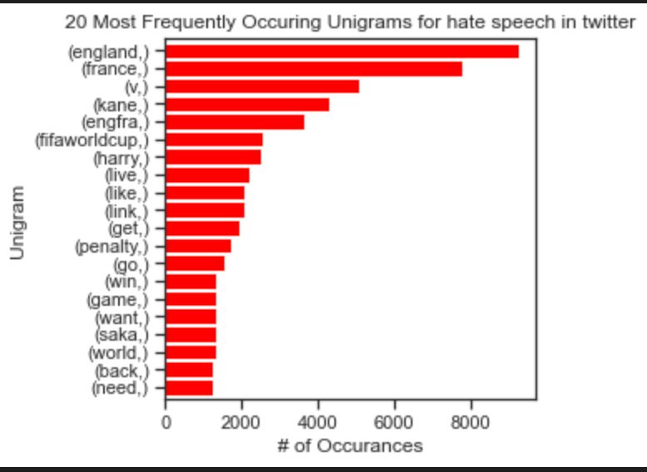
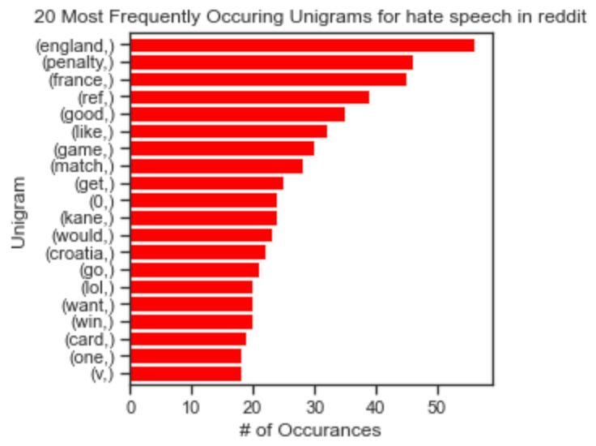
Hate speech in training data
Ethnicity based hate speech in training data
Hate speech on Twitter
Hate speech on Reddit

Slide 15
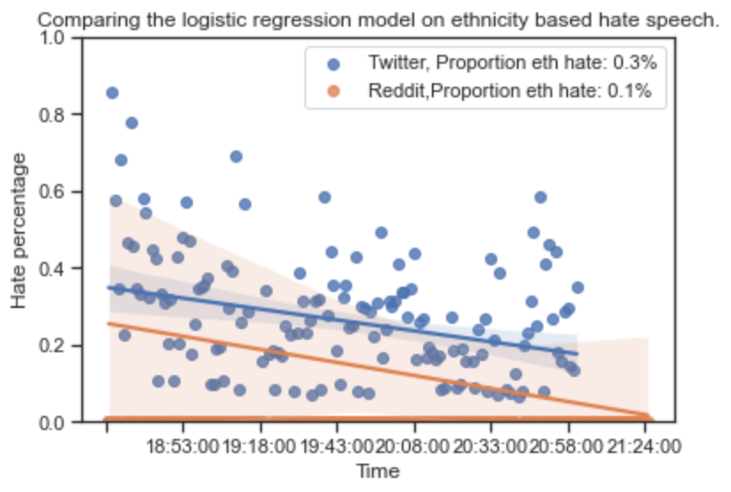
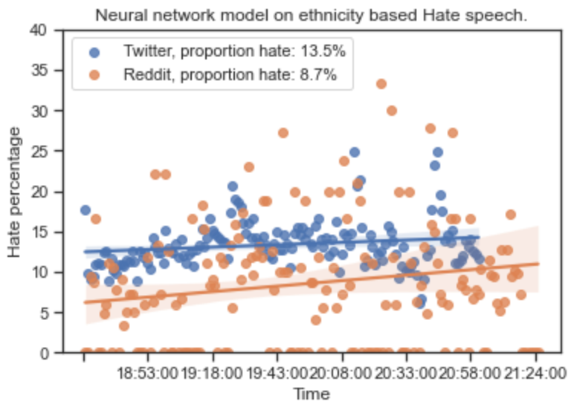
Ethnicity-based Hate speech models
Logistic regression on Hate speech
Neural network on Hate speech

Slide 16

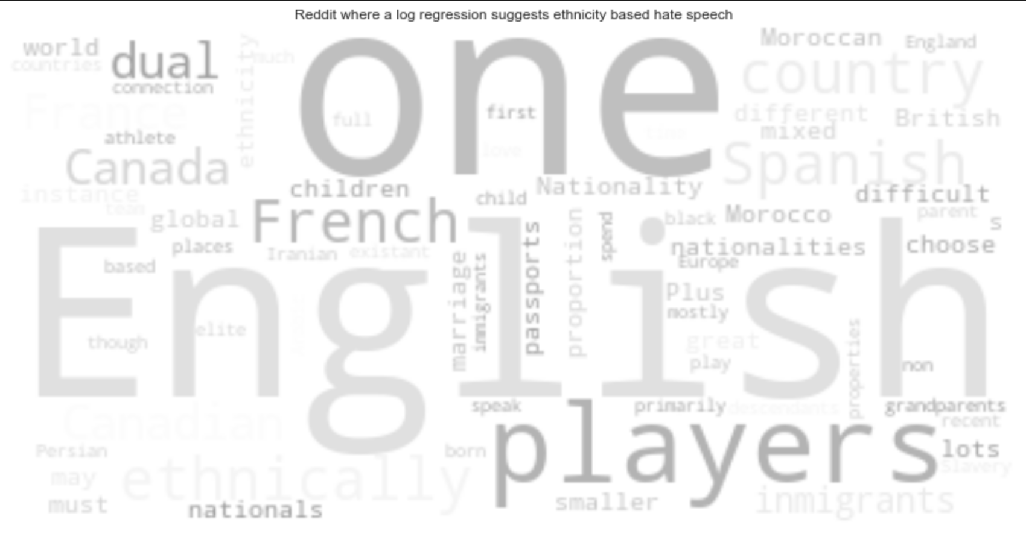
What kind of language do we see on twitter vs Reddit when ethnicity hate speech is flagged?
Twitter results for ethnicity-based hate speech
Reddit results for ethnicity-based hate speech

Slide 17
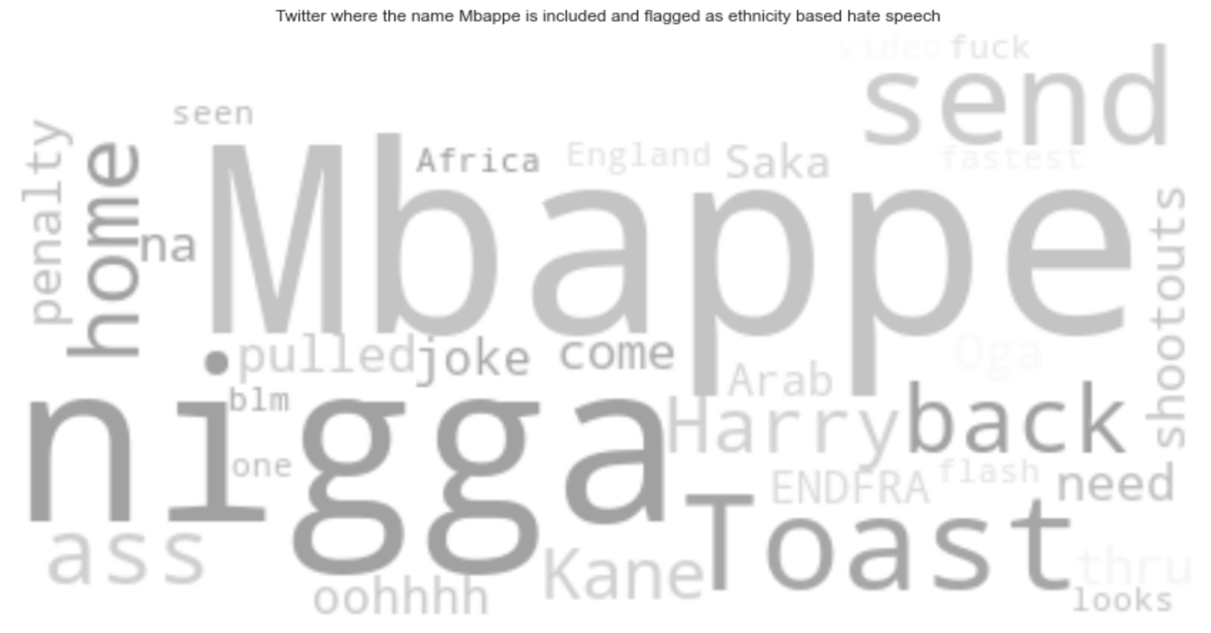
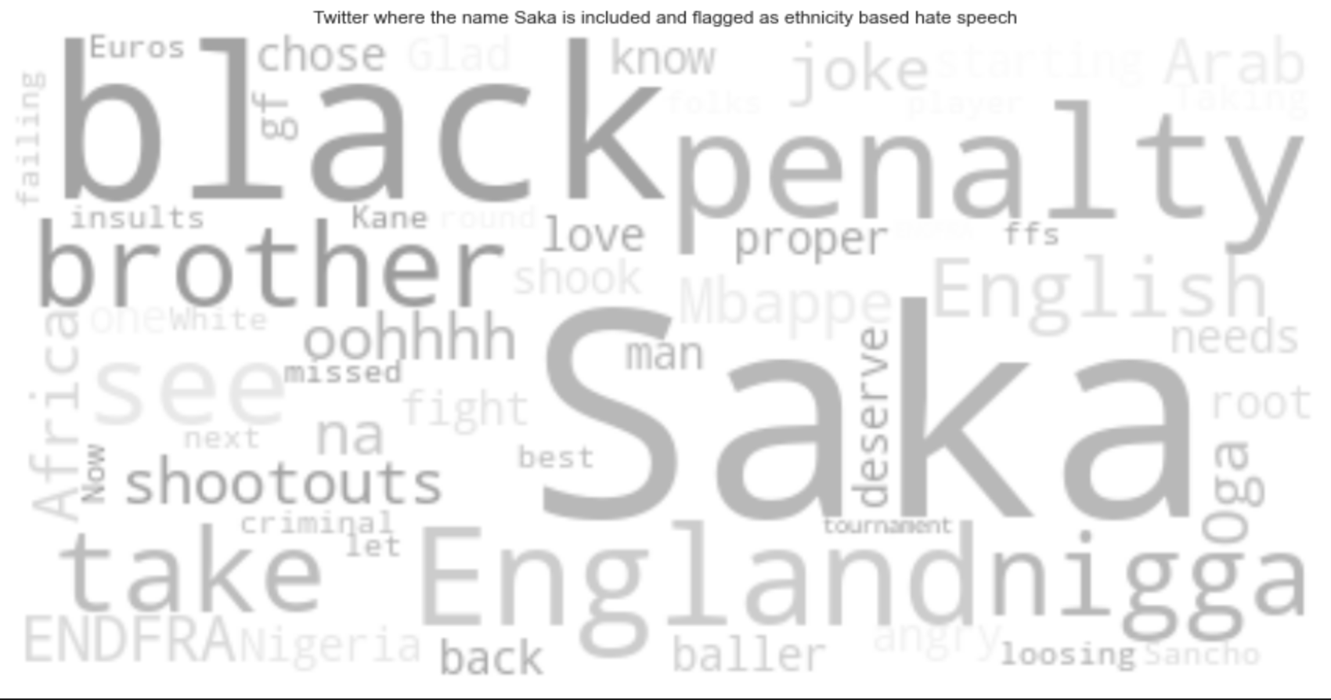
Word clouds showing player specific ethnicity-based hate speech
Twitter results using logistic regression
No ethnicity-based hate speech for Saka or Mbappe was picked up by the logistic regression on Reddit

Slide 18
Thank you for listening

Slide 19
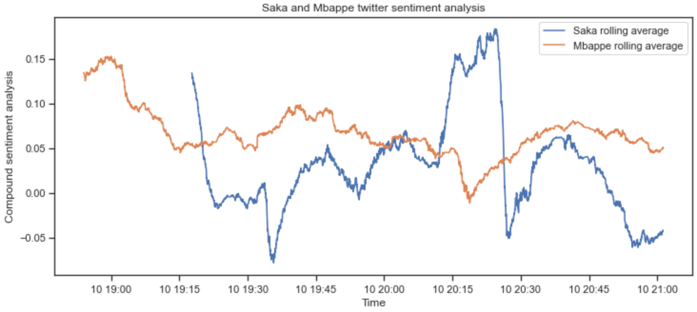
Sentiment analysis on select players
Penalty missed for England after Giroud scores
Saka comes off
Kickoff
Penalty scored for England
Tchoumeni scores for France and Saka fouled

